Slide 1
Engineering Interactive Visual Interfaces for Data Science (“The CS Data Vis Class”)
xkcd

Slide 2
Friday February 9
Engineering Interactive Visual Interfaces for Data Science
“The CS Data Vis Class”
Dr. Jillian Aurisano
Plan for today:
Logistics (5 min)
Color
Activity

Slide 3
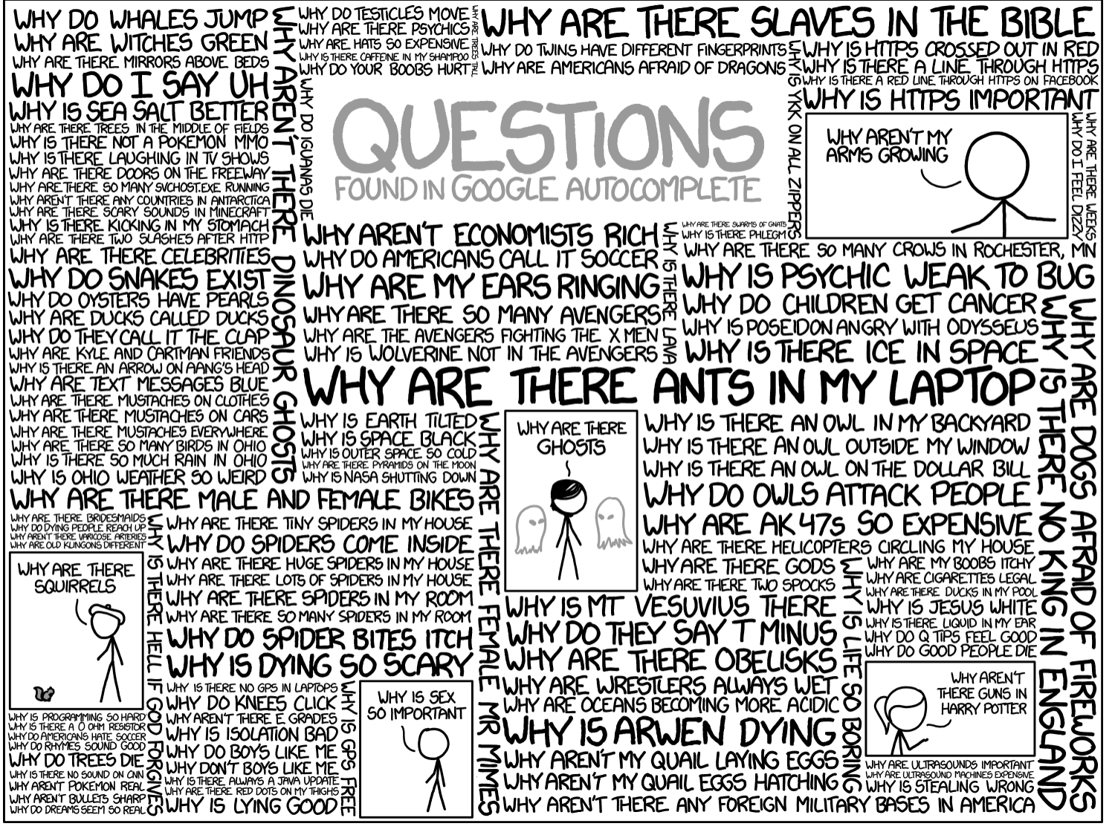
Questions?

Slide 4
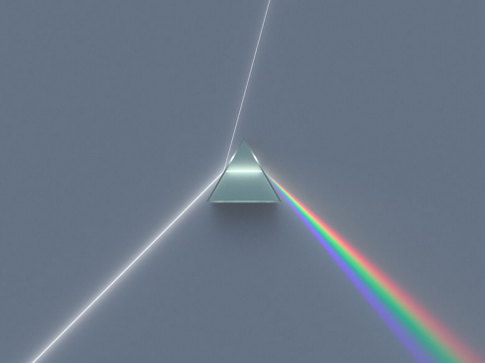
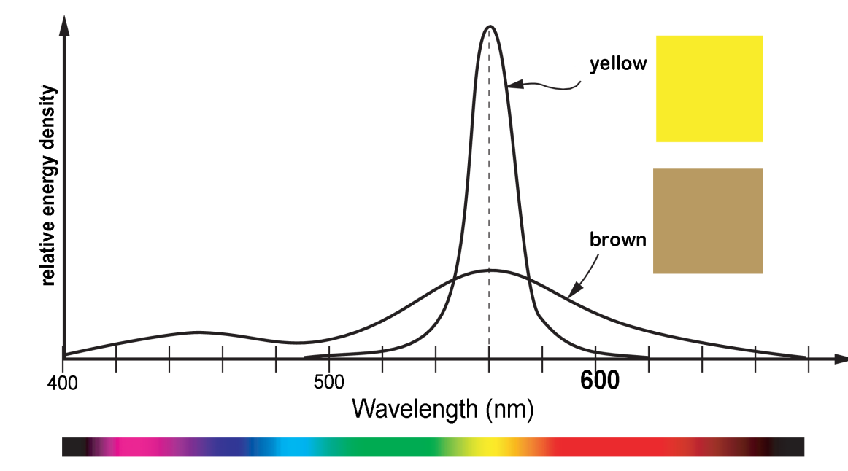
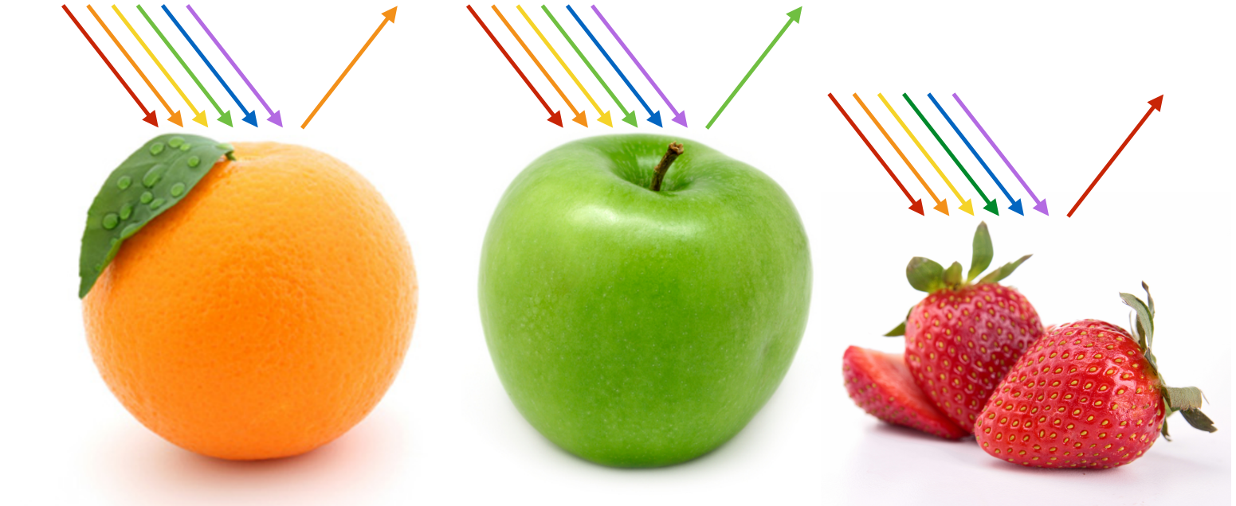
What is color?
Color from a physics perspective- wavelength and energy of light
Color in the eye- activation of cones
Color model, which we use to make visualizations

Slide 5
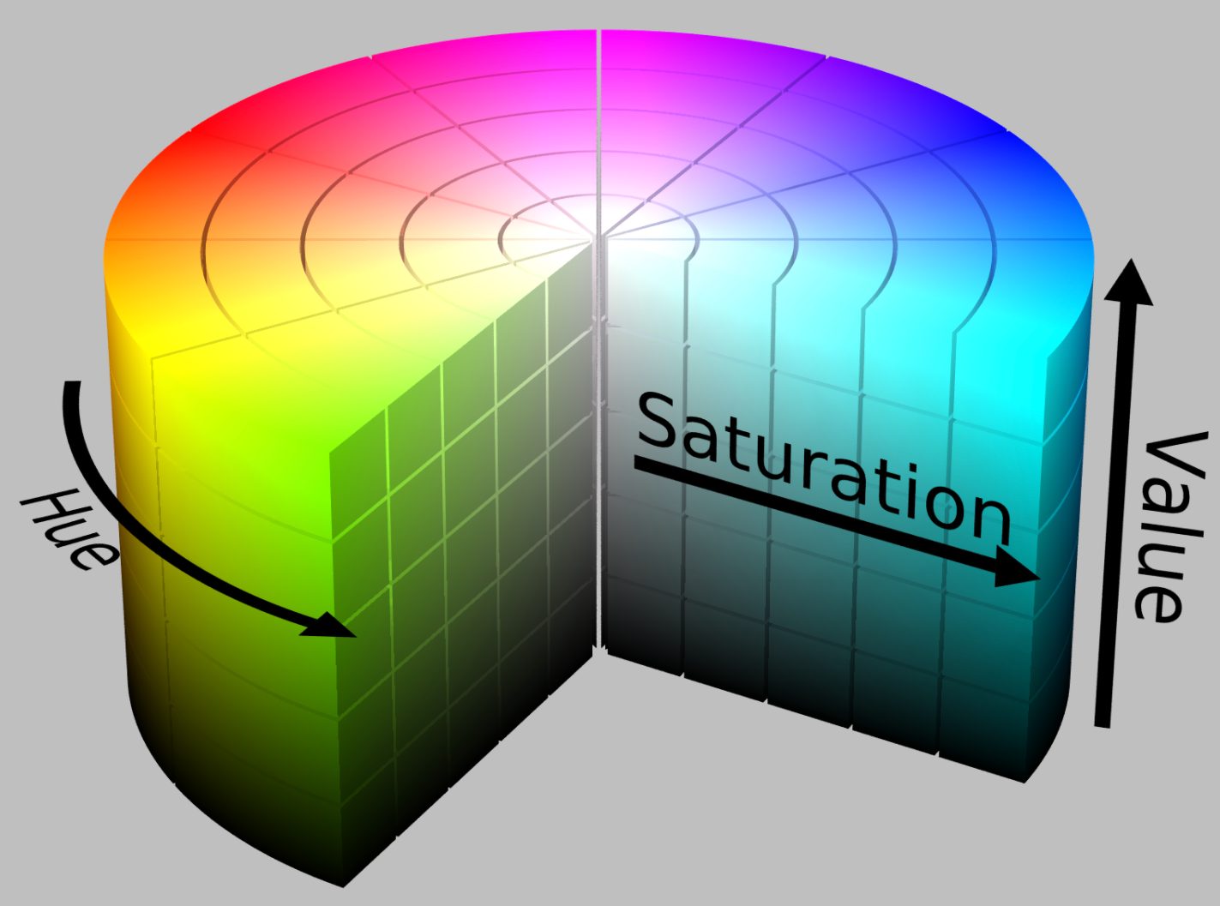

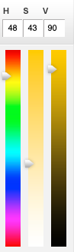
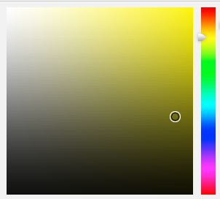

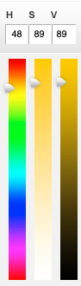

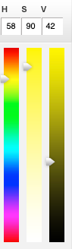
Intuitive color model
3 Dimensions of color:
Hue (red, orange, yellow….)
Saturation
“Purity of the color”
From white to an intense hue
Value
Darkness of the color

Slide 6
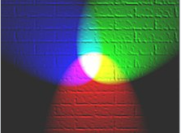
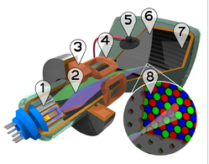

Alternate color model: RGB (Red, Green, Blue)
RGB
Red value (0-255, or 0.0-1.0)
Green value (0-255, or 0.0-1.0)
Blue value (0-255, or 0.0-1.0)
Light , how displays work
RGB is additive
Light spectra add together to produce the color
Displays use RGB in how they present color to users
Closely positioned red, green and blue light sources - > pixel color at that spot

Slide 7
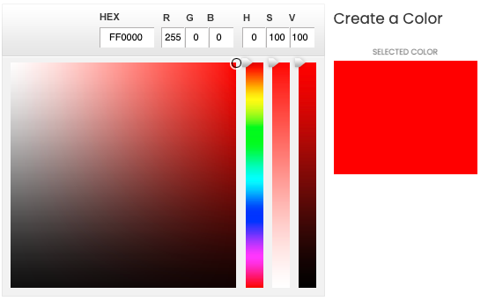
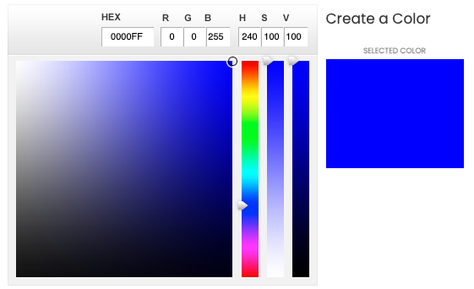
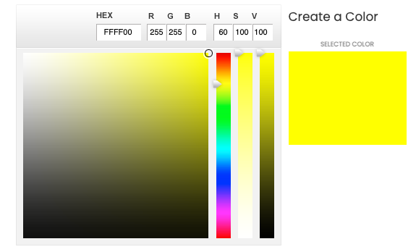
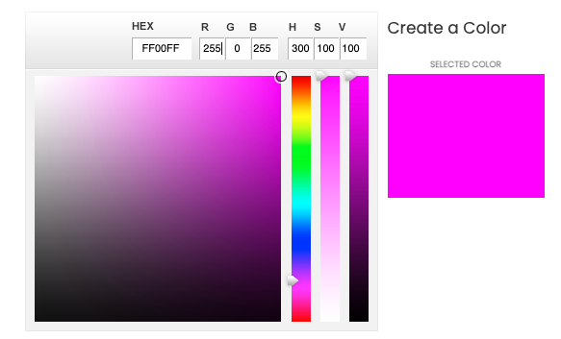
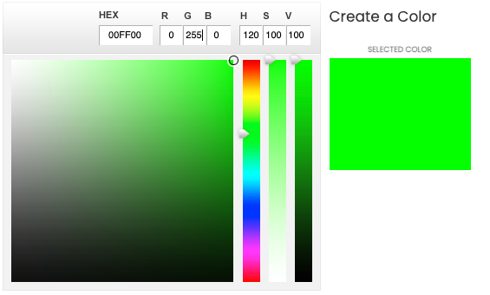
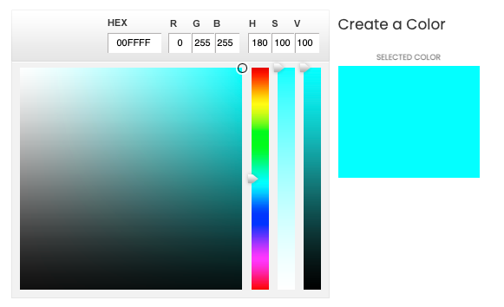
RGB values and color outputs

Slide 8
You can make your own colors, color palettes
You can use RGB values – color lovers site and many others
You can use html named colors : https://www.w3schools.com/colors/colors_names.asp
For data –you can use color maps

Slide 9
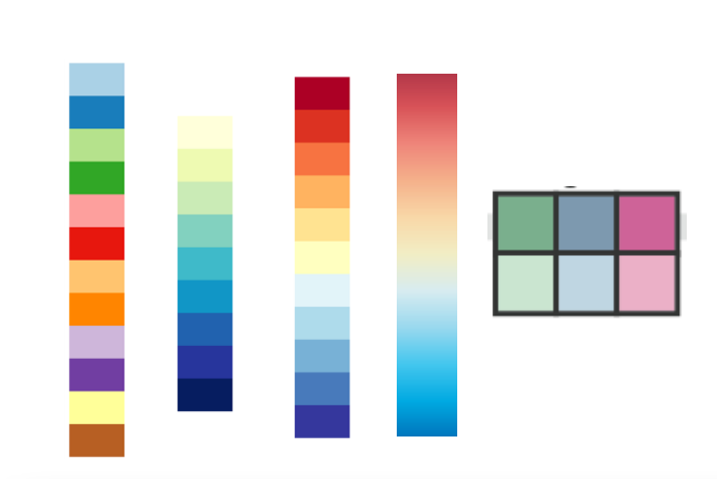
Color map
Encoding data with colors
Picking a mapping between colors and values in a dataset
Choosing an appropriate color map is important
Color map that conveys the data effectively
A
B
C
D

Slide 10
Color map
Which would you choose for this data:
How likely a region is to experience a flood, from not very likely to very likely
A
B
C
D

Slide 11
Color map
Sequential
Multi-hue (yellow to blue)
Also could do Single hue
Which would you choose for this data:
How likely a region is to experience a flood, from not very likely to very likely
A
B
C
D

Slide 12
Color map
Which would you choose for this data:
A line chart showing trends in the value of tech companies over the last decade, where each line is one technology company (Google, Microsoft…)
Using color to differentiate each company.
A
B
C
D
E

Slide 13
Color map
Which would you choose for this data:
A line chart showing trends in the value of tech companies over the last decade, where each line is one technology company (Google, Microscoft…)
Using color to differentiate each company.
Qualitative (Categorical)
A
B
C
D
E

Slide 14
Color map
Which would you choose for this data:
On a US map, color states by voting patterns in a Presidential election to highlight how strongly the state leaned towards Democrats or Republicans
A
B
C
D

Slide 15
Color map
Diverging
Which would you choose for this data:
On a US map, color states by voting patterns in a Presidential election to highlight how strongly the state leaned towards Democrats or Republicans
Binned
Continuous
A
B
C
D

Slide 16
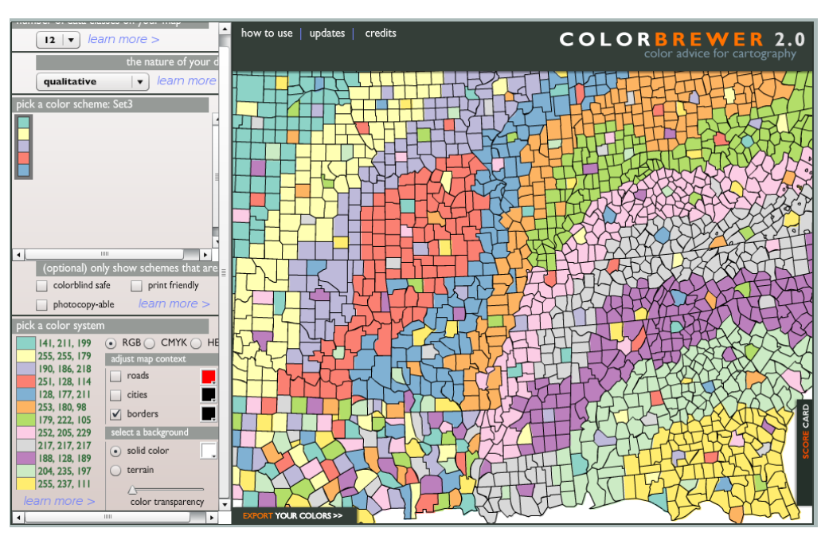
Color selection tools
Color brewer
https://colorbrewer2.org
Generate a few color schemes with your group, and invent an appropriate data attribute that they are depicting
Ex- Temperature? Rate of flooding? Most dominant industry?

Slide 17
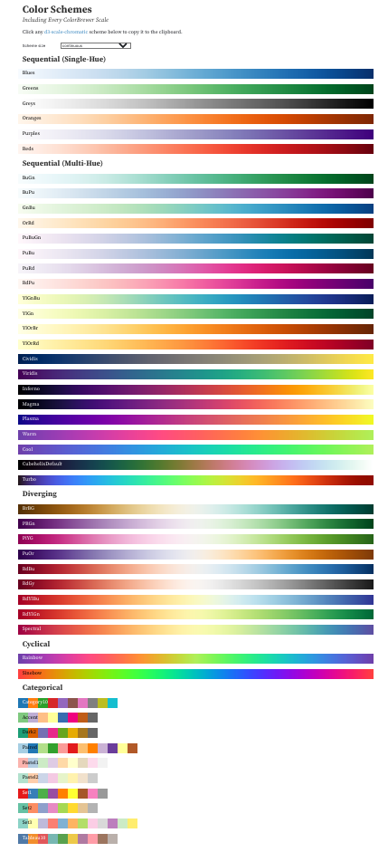
D3 color scales

Slide 18
Color is a strong visual channel
But there are some guidelines for how to use color in data visualizations

Slide 19
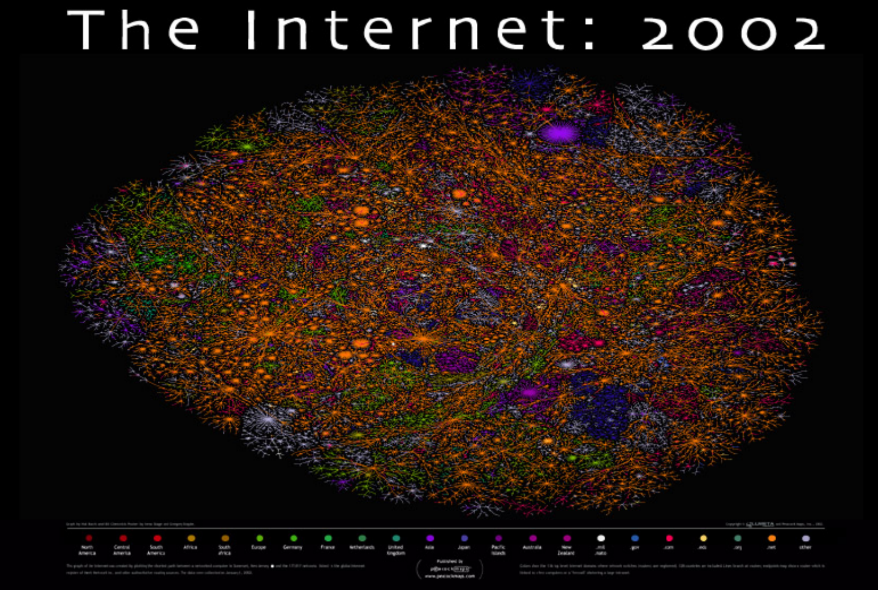
Critique
Each color is a region

Slide 20
Colors for qualitative data (labels, categories, names)
Recommendation: about 6, no more than 10.
You can’t distinguish colors very well above 10 different colors

Slide 21
Colors for qualitative data
Too many colors, we can’t meaningfully distinguish them
Or recall what they relate to
22 Colors, only 8 were distinguishable
Also- are ‘red’ things similar?
Our brains will associate them
In this case- maybe don’t encode with color only

Slide 22
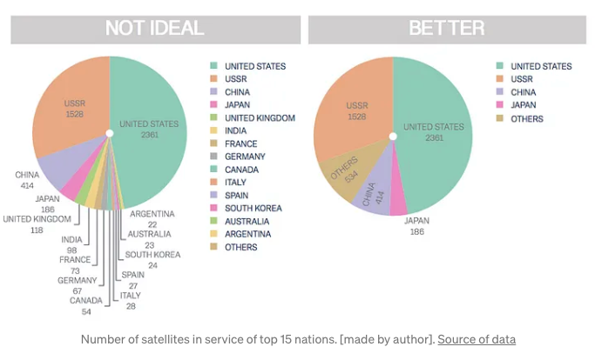
Categorical colors
https://towardsdatascience.com/8-rules-for-optimal-use-of-color-in-data-visualization-b283ae1fc1e2

Slide 23
Colors for quantitative data
Standard guidelines for vis is to not use rainbow color maps
Better to :
Monochromatic scales
A ramp from one color to another (Multi-hue)
Or for a diverging scale, two ramps to two hues that terminate in a common middle point
Why?
Reasons: boundaries between hue are arbitrary, not related to the data
Ex. Encoding how much people participated in Wikipedia editing, why are some people yellow vs green vs blue as opposed to “more or less” scale

Slide 24
Colors for quantitative data
Standard guidelines for vis is to not use rainbow color maps
Better to :
Monochromatic scales
A ramp from one color to another (Multi-hue)
Or for a diverging scale, two ramps to two hues that terminate in a common middle point
Why?

Slide 25
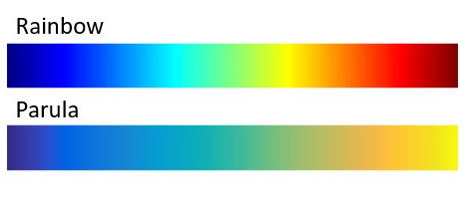
Colors for quantitative data
Standard advice is not use hue (not to use a rainbow color map)
Better to use saturation
or a single ramp from one color to another
Why?

Slide 26
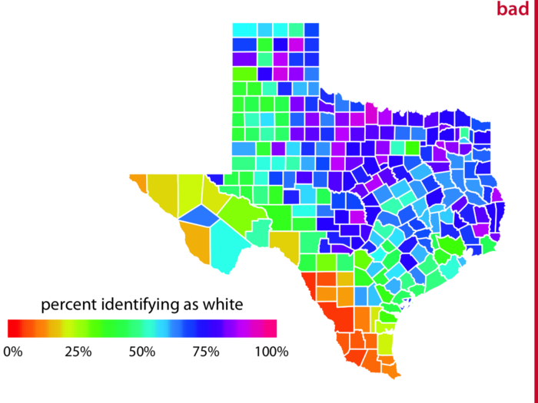
Why not use rainbow color maps?
Map of Texas counties
Without the key, do you understand these values?
Which counties are high?
Which are low?
Is a county colored green closer toa county colored orange or pink?

Slide 27
Why not use rainbow color maps?
Map of Texas counties
Without the key, do you understand these values?
Which counties are high?
Which are low?
Is a county colored green closer toa county colored orange or pink?

Slide 28
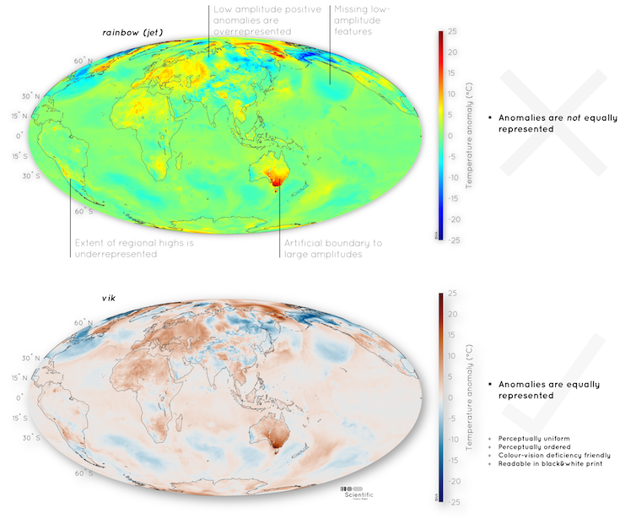
Another example
Look at Australia- Looks like it has lots of variations- red, orange, yellow, green….
Look at the oceans- it looks somewhat uniform, with a few small patches of yellow

Slide 29
Another example
Look at Australia with a divergent color scale
Looks more like a continuous range with a few extrema
And the oceans
Did you notice those depressions in the rainbow color map?

Slide 30
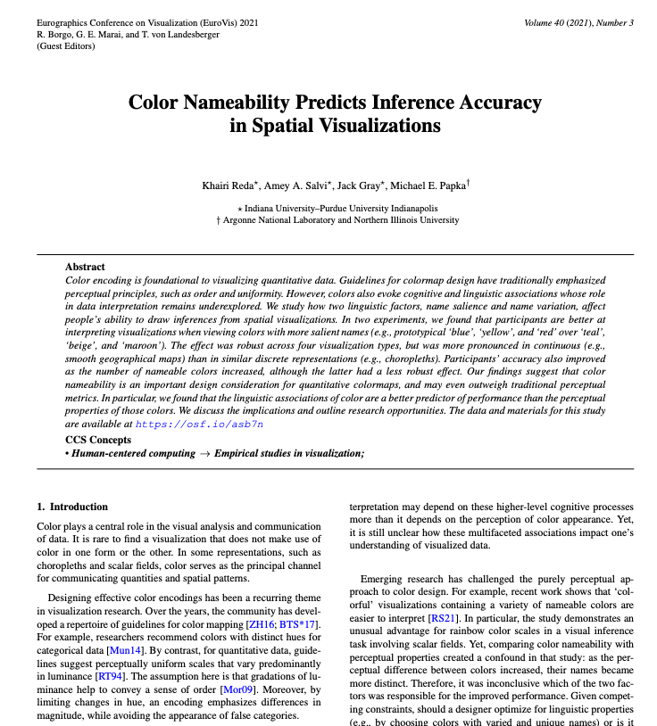
But… Rainbow color maps making a comeback?
Some prominent vis researchers :
“My domain sciences collaborators want rainbow color maps”
”I tried using a non-rainbow color map. And my users found it more confusing”
Rainbow color maps were easier to interpret and preferred by users
Rainbow color maps made it easier to remember data
Controversy continues….
(don’t bring it up at a Vis conference people have strong feelings….)

Slide 31
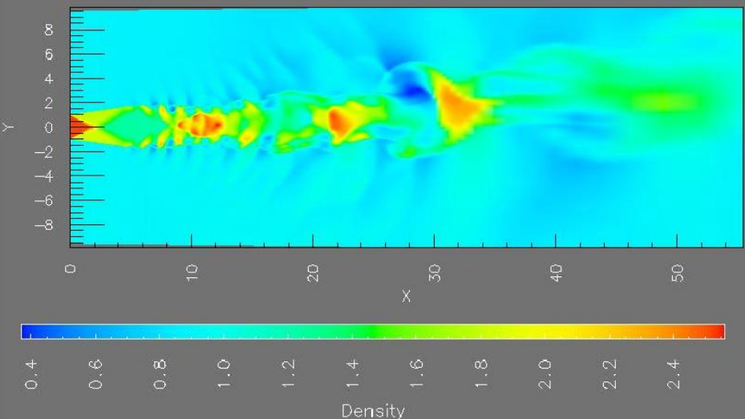
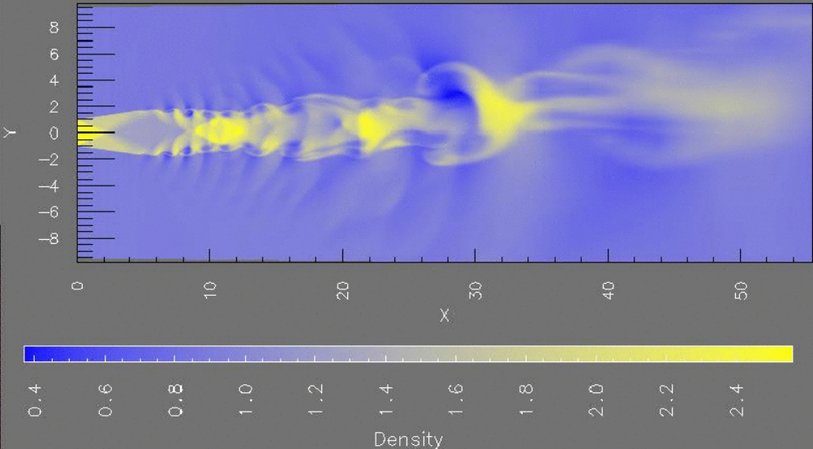
What do you think?

Slide 32
What do you think?
Good for spotting extrema
Might create the impression that some regions are “different”
Ex. The green looks like a uniquely labeled phenomena
Corresponds with the data
But, might not be preferred by the users

Slide 33
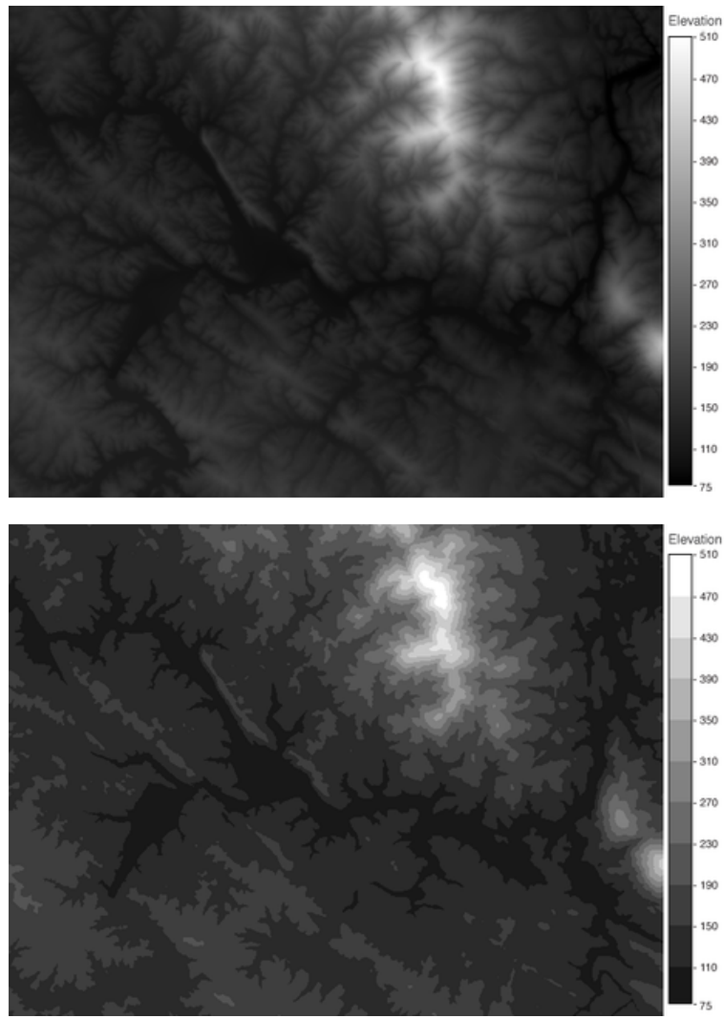
Continuous or binned?
Which is more accurate? Which is faster?

Slide 34
Continuous or binned?
Which is more accurate? Which is faster?
Empirical results:
Binned was more accurate
Continuous was faster

Slide 35
Color blindness
10% of males and 1% of females have one of several forms of color blindness
Most common: Red, green color blindness, but there are others
Let’s see how we all do…
(sometimes someone discovers they are color blind in class =O )
Do you see these numbers?

Slide 36
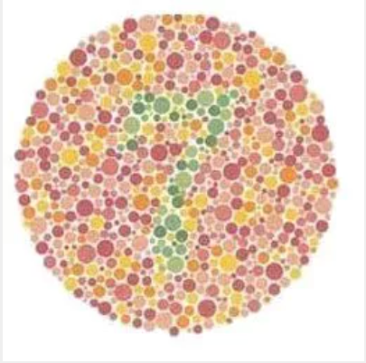

Slide 37
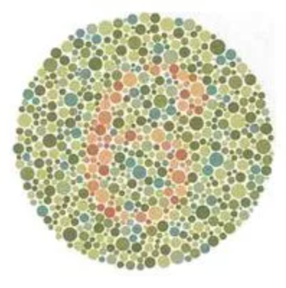

Slide 38
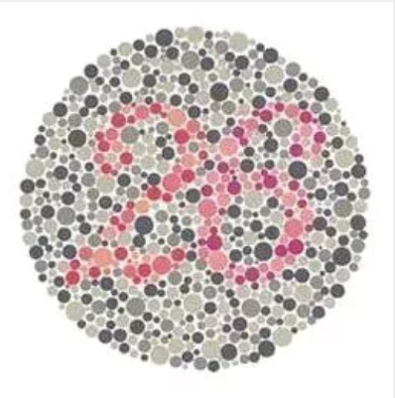

Slide 39
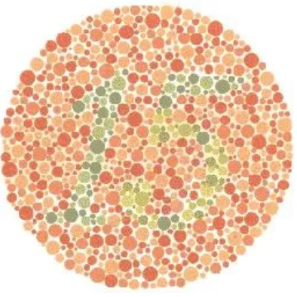

Slide 40
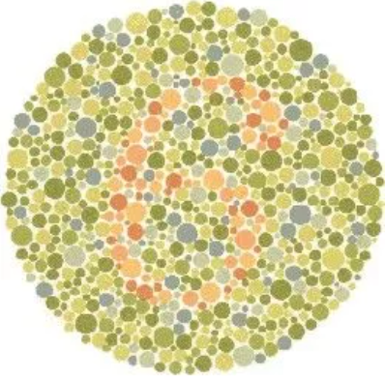

Slide 41
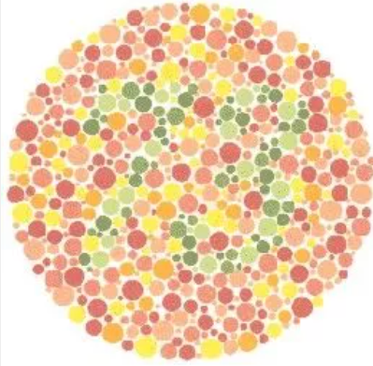

Slide 42
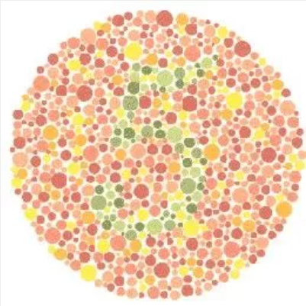

Slide 43
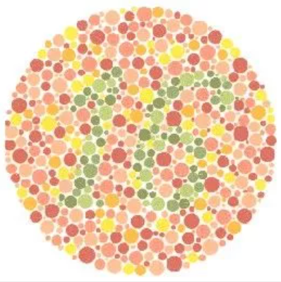

Slide 44
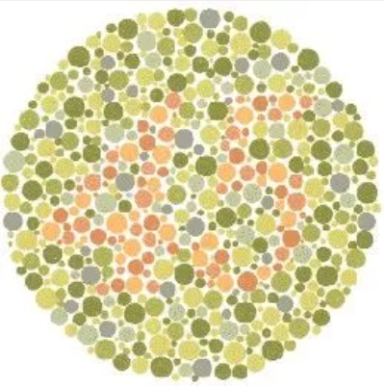

Slide 45
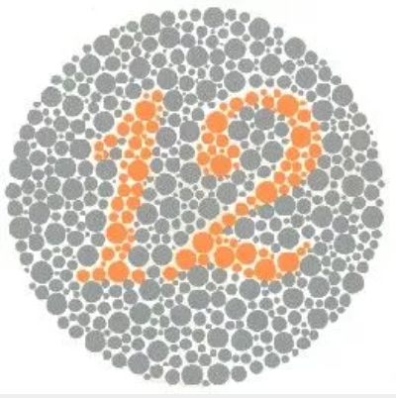

Slide 46
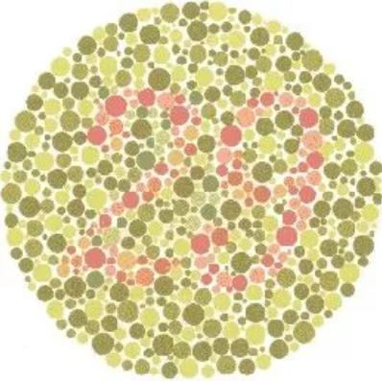

Slide 47
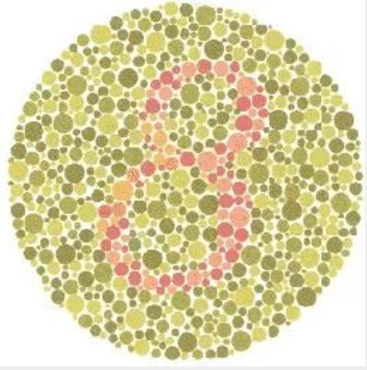

Slide 48
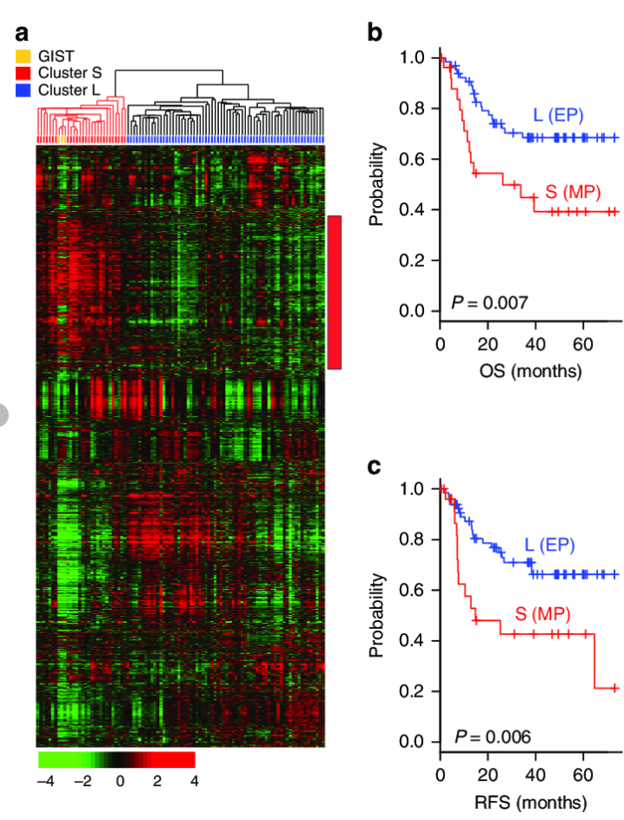
Designing for color blindess
Gene expression data
Don’t use red, green color scales!!

Slide 49
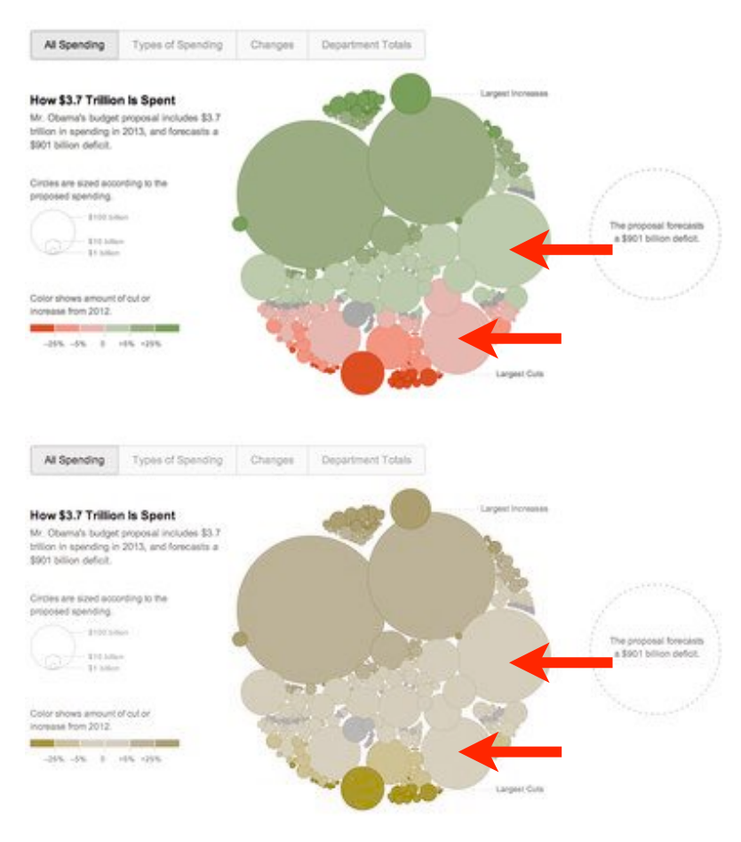
Another example
Example from the NYT
Top is non-color blind perspective
Bottom is color blind perspective

Slide 50
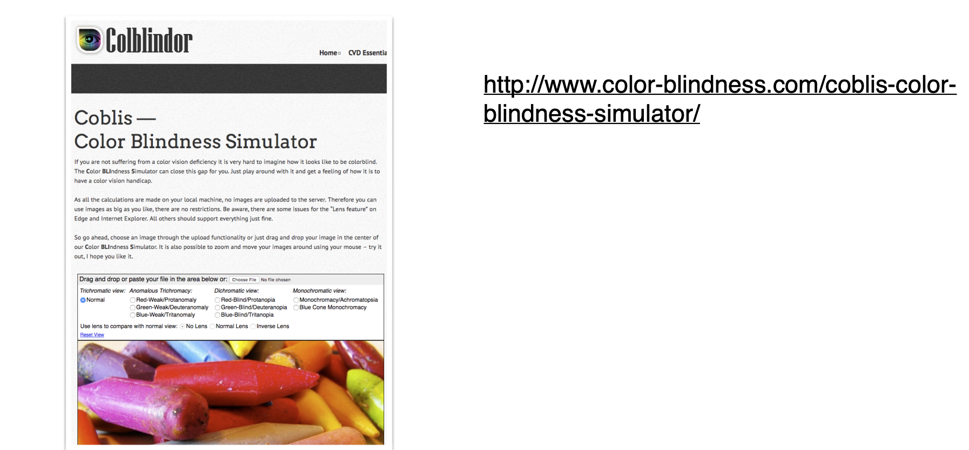
Check for color blindness

Slide 51
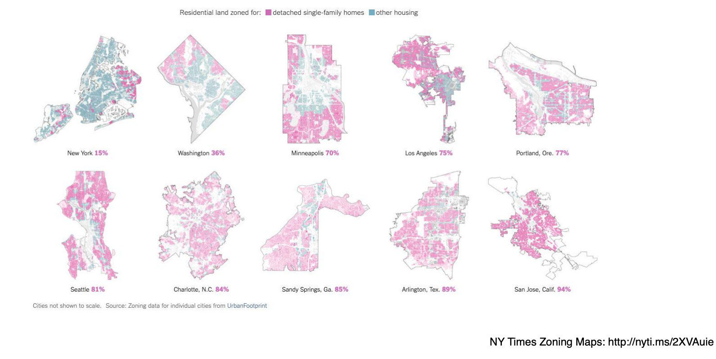
Another example before checking
Show zoning patterns

Slide 52
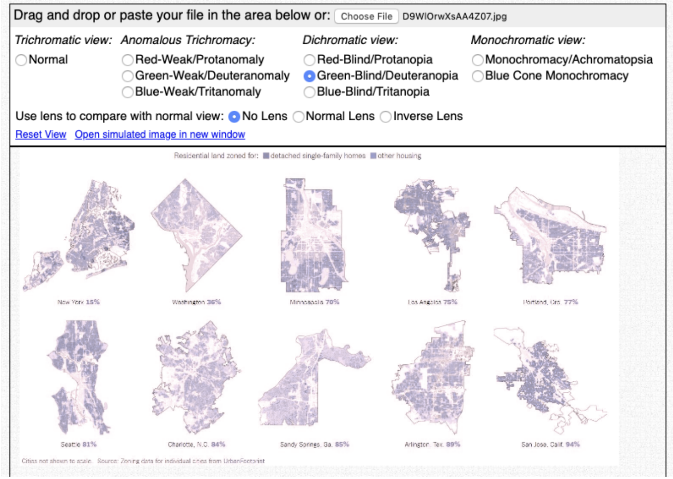
Checked for color blindess

Slide 53
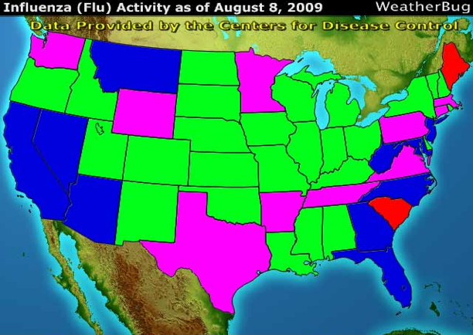
There are lots of bad uses of color in vis….
Make a guess- which colors are for lots of flu cases?

Slide 54
There are lots of bad uses of color in vis….
Make a guess- which colors are for lots of flu cases?

Slide 55
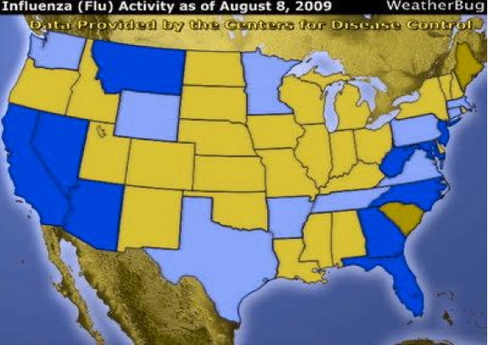
Color blind test?

Slide 56
Activity
Let’s make some ‘bad’ color schemes
Come up with a color scheme that is going to
Not match the data
Be hard to interpret
Take a minute to think of a few and we will reconvene

